Slide 1
Thread-Safe Priority Queue
Group 6
Yong Wan
Hualong Zhu
Zhihao Zhang
Notes:
Hello everyone, today we will talk about thread-safe priority Queue. We are group 6. This is Yong and this is Long. And my name is zhihao.

Slide 2
Outline
Priority Queue
PriorityBlockingQueue ( Binary heaps )
Other Queues
· LockFreePriorityQueue
· Pipelined PriorityQueue
Notes:
So first, I’ll indicate what the priority queue is. Then I’ll introduce a thread-safe priority queue which is called PriorityBlockingQueue. And Yong will talk about LockFreePriorityQueue. Finally, Long will introduce Pipeline PriorityQueue. So what is priority queue?

Slide 3
Priority queue
Unbounded Queue in Java
Priority Heap
Particular Order -- Natural Order
-- Custom Order (Comparator interface)
Fundamental Data Structure
Using frequently -- Operating system level
-- User application level
Notes:
Priority Queue is an unbounded queue implementation in Java, which is based on priority heap.
Priority Queue allows you to keep elements in a particular order, according to their natural order or custom order defined by Comparator interface in Java.
Priority Queues are fundamental data structures. From operating system level to the user application level, they are frequently used as basic components.

Slide 4
Functions of a priority queue
The abstract definition of a priority queue is “a set of key-value pairs, where the key represents a priority” (Braginsky et al., 2016).
Operations: Put and Poll operation
The Put operation inserts a new key-value pair into the set
The Poll operation removes and returns the value of the key-value pair with the lowest key (i.e. highest priority) that was in the set.
Notes:
The abstract definition of a priority queue is a set of key-value pairs, where the key represents a priority. It supports several operations, like put and poll.
The Put operation inserts new key-value pair into the set,
And the Poll operation removes and returns the value of the key-value pair with the lowest key which has highest priority.

Slide 5
Weakness of Priority Queue
Priority Queue cannot be shared safely between multiple threads because it is not synchronized.
Instead, its concurrent counterpart PriorityBlockingQueue is thread-safe and could be used in multithreaded environment.
Notes:
But the most important thing here is that because PriorityQueue is not synchronized, which means it cannot be shared safely between multiple threads. Instead, its concurrent counterpart PriorityBlockingQueue is thread-safe and could be used in multithreaded environment.

Slide 6
PriorityBlockingQueue
PriorityBlockingQueue is an unbounded concurrency-safe priority Queue (FIFO) based on the priority heap. The elements of the queue are sorted in their natural order or sorted according to the Comparator provided when the queue is constructed, depending on the method of construction used.
The bottom of the PriorityBlockingQueue is implemented by a binary heap.
Notes:
The only and also the biggest difference between PriorityQueue and PriorityBlockingQueue is that PriorityBlockingQueue is concurrency-safe.
Because the bottom of the PriorityBlockingQueue is implemented by a binary heap, it is necessary to introduce binary heap first.

Slide 7
Binary heap
A binary heap is a complete binary tree which satisfies the heap ordering property. The ordering can be one of two types:
Min-heap property: the value of each node is greater than or equal to the value of its parent, with the minimum-value element at the root.
Max-heap property: the value of each node is less than or equal to the value of its parent, with the maximum-value element at the root.
Notes:
A binary heap is a complete binary tree which satisfies the heap ordering property. The ordering can be one of flowing two types.
Min-heap and Max-heap.
Here are the properties of these two types.

Slide 8
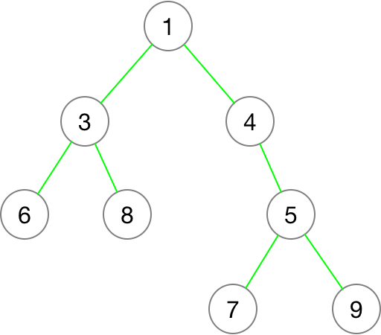
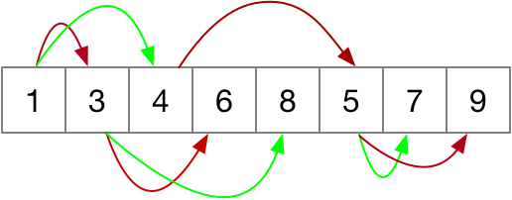
Binary heap
The binary heap is generally represented by an array.
If the node position of the parent node is in N. Then the left child node is : 2*N+1, the right child node is 2*N+2 and its parent node is (N-1)/2.
Notes:
The binary heap is generally represented by an array, and if the node position of the parent node is in N.
Then the left child node is: 2*N+1,
the right child node is 2*N+2
and its parent node is (N-1)/2.
Here we use min-heap as an example.
So how to insert and delete an element in binary heap?

Slide 9
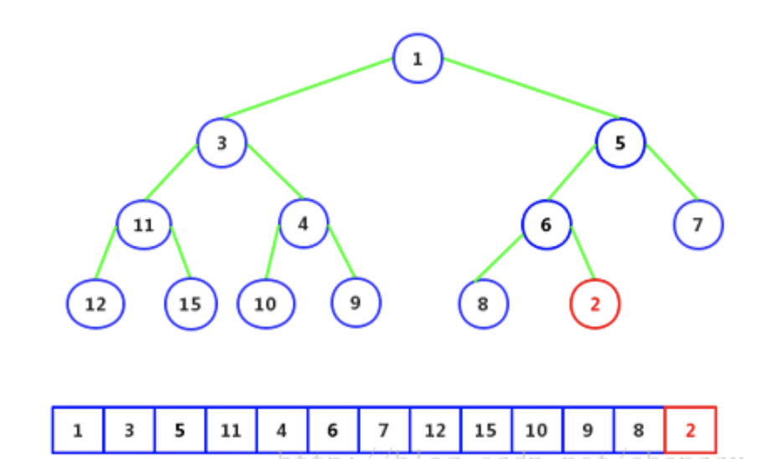
Insert element - 1
As sited in : https://blog.csdn.net/chenssy/article/details/76409396
Notes:
If we want to insert an element 2 to the existing binary heap like this.
Firstly, add the element 2 at the end of the array. We find that 2 is smaller than its parent node 6,

Slide 10
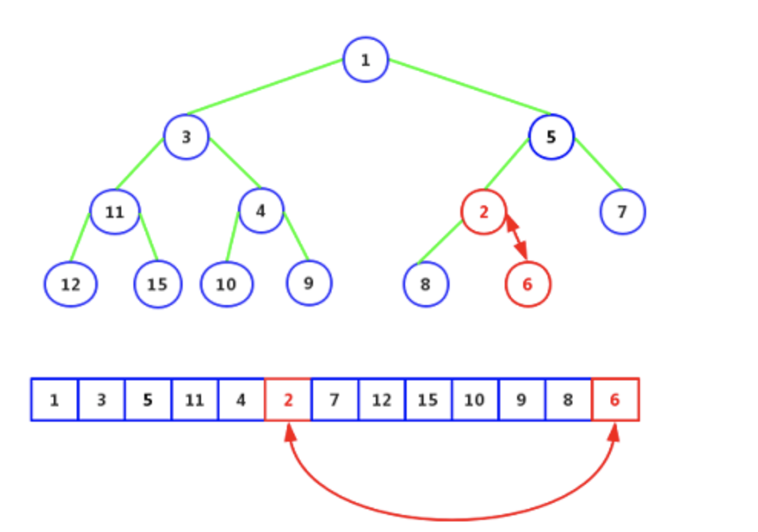
Insert element - 2
As sited in : https://blog.csdn.net/chenssy/article/details/76409396
Notes:
Replaced 6 by 2. Continue to compare to its parent node 5. Less than 5,

Slide 11
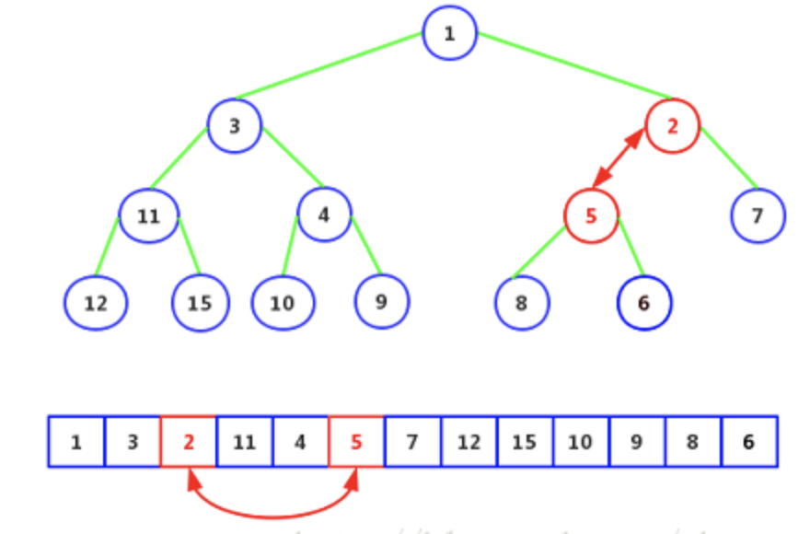
Insert element - 3
As sited in : https://blog.csdn.net/chenssy/article/details/76409396
Notes:
Replace~ continue to compare with node 1 and find that the node 1 is smaller than 2. So the whole process is completed.
So the whole process of adding elements can be summed up by inserting an element at the end of the array, and then comparing the substitution until it cannot be moved.

Slide 12
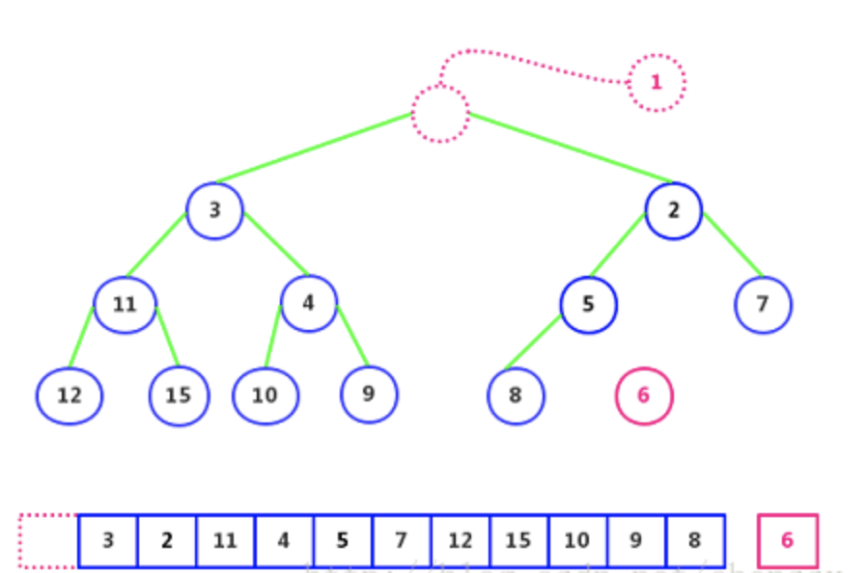
Delete element - 1
As sited in : https://blog.csdn.net/chenssy/article/details/76409396
Notes:
Next, let’s have a look of deleting element.
For the above binary heap,the deleted element is element 1.
Firstly, erase element 1 and separate element 6

Slide 13
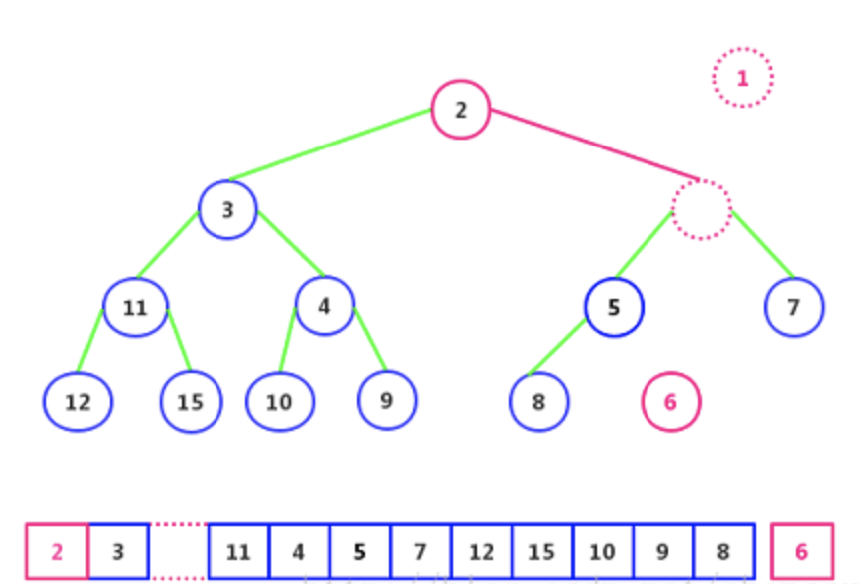
Delete element - 2
As sited in : https://blog.csdn.net/chenssy/article/details/76409396
Notes:
Secondly, compared to its two child nodes element 2 and element 3.
Put the smaller element 2 into the hole.

Slide 14
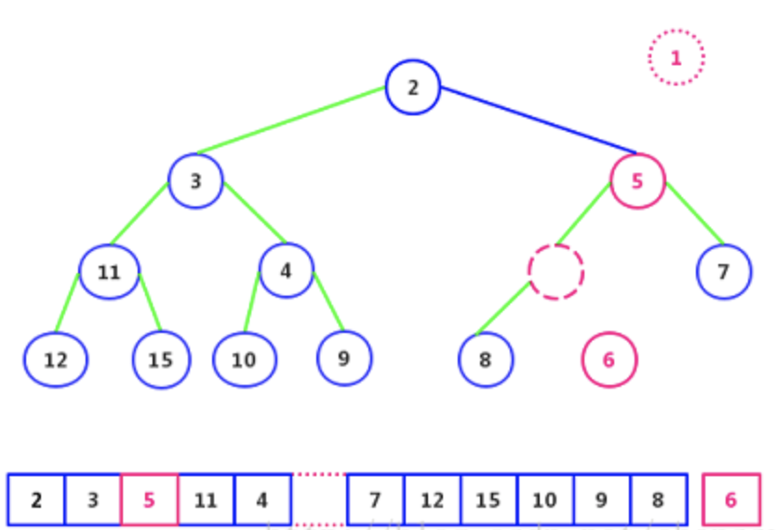
Delete element - 3
As sited in : https://blog.csdn.net/chenssy/article/details/76409396
Notes:
And then continue comparing two child nodes element 5 and element 7.
Place the smaller element 5 into the hole.

Slide 15
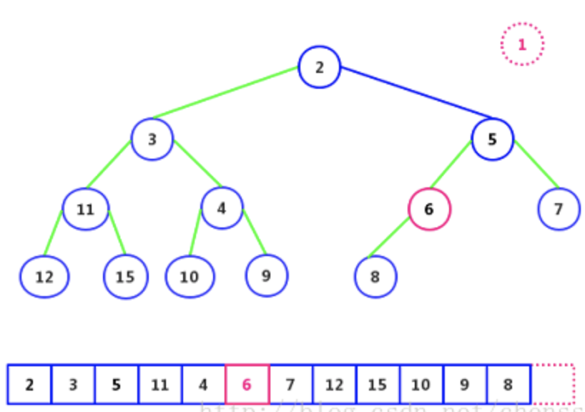
Delete element - 4
As sited in : https://blog.csdn.net/chenssy/article/details/76409396
Notes:
Finally, according to the same principle, put element 6 into the void position.

Slide 16
The implementation of PriorityBlockingQueue
Priorityblockingqueue provides
put (), add () and offer () methods to add elements to the queue
poll () and remove () methods to remove elements.
Notes:
OK, Next, the implementation of PriorityBlockingQueue.
Priorityblockingqueue provides put (), add () and offer () method to add elements to the queue
and poll () and remove () methods to remove elements.

Slide 17
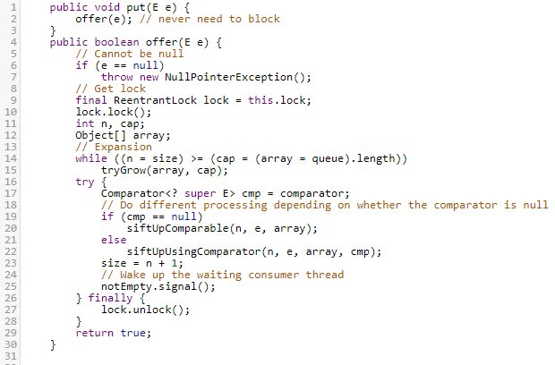
Example
Notes:
Here is an example of adding element to a queue,
Here we start with put.
Put (E e) means inserting the specified element into this priority queue.
It will get lock and do different processing depending on whether the comparator is null, and finally it will unlock the operation.

Slide 18
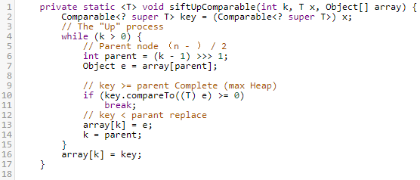
siftUpComparable method
Notes:
When comparator is null, the program uses a natural sort, calling the siftUpComparable method.

Slide 19
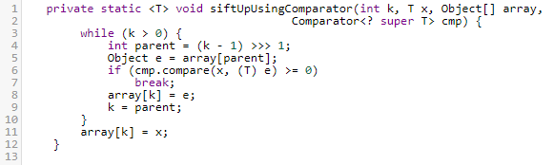
siftUpUsingComparator method
Notes:
When comparator is not null, using the specified comparator calling the siftUpUsingComparator method.

Slide 20
‘Up’ method
Notes:
The whole process of adding an element is exactly the same as the previous binary heap: add the element to the end of array at first, and use the ‘ up ‘ method to take the element up as far as possible.

Slide 21
Weakness of PriorityBlockingQueue
Other concurrent operations cannot make any progress while the access to the shared resource is blocked by the lock.
Using mutual exclusion can cause deadlocks and priority inversion.
Notes:
Although the priorityBlockingQueue is thread-safe, other concurrent operations cannot make any progress while the access to the shared resource is blocked by the lock. And also, using mutual exclusion can cause deadlocks and priority inversion.
So do we have any other choices? Now I will hand it over to Yong.

Slide 22
Other Choices
LockFreePriorityQueue
Hakan Sundell and Philippas Tsigas had provided a new method address these problems in a paper <<Fast and Lock-Free Concurrent Priority Queues for Multi-Thread Systems>>. raja implemented it in Java.
Pipelined PriorityQueue
Notes:
Hi,I am Yong Wan, Simon just showed you the weakness of PriorityBlockingQueue, actually, we do have some other choices to address these problems. In my part, I will introduce LockFreePriorityQueue and Long will introduce PipelinedPriorityQueue.
LockFreePriorityQueue was initially introduced by Hakan and Philippas and implemented in C++. Then Raja implemented it in java.

Slide 23
The structure of LockFreePriorityQueue
Skip List :
This structure uses randomization and has a probabilistic time complexity of O(log N) where N is the maximum number of elements in the list. The data structure is basically an ordered list with randomly distributed shortcuts in order to improve search times The maximum height (i.e. the maximum number of next pointers) of the data structure is log N. The nodes with highest priority are located first in the list.
Notes:
The main structure of LockFreePriorityQueue is skiplist. This structure uses randomization and has a probabilistic time complexity of O(log N) where N is the maximum number of elements in the list. The data structure is basically an ordered list with randomly distributed shortcuts in order to improve search times.
The maximum height of the data structure is log N.The nodes with heightest priority are located first in the list.

Slide 24
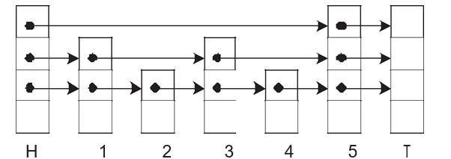
Skiplist
Height2：
Height1：
Next：
Data：
Notes:
This is a graph of a skiplist. As you can see, There are three levels showing in the graph. While H means Head and T means Tail, these two nodes are fixed in every skiplist, other nodes are normal data nodes. the height 2 level only has Node H and 5 and T, and then the height 1 level has node H,1 then 3 then 5 and T. the lowest level “next” goes through the all nodes.
For example, when we do a search for a node equals 4, At first we start from the Highest level which is Height2, we compare the first node after H which is 5 and it is great than 4。so ,we go to the lower level which is Height1 ， then we still compare the first node after H which is 1, because 1 is less than 4 ,so we go to
the next node three which is also less than 4, so we keep going to his next node 5, which is great than 4 again, so we should go back node three and then lower down the level which goes to level（next), then we get node 4.

Slide 25
How to assure that the skip list remains concurrent without blocking?
In order to make the skip list construction concurrent and non-blocking, we are using three of the standard atomic synchronization primitives, Test-And-Set (TAS), Fetch-And-Add (FAA) and Compare-And-Swap (CAS). the specification of these primitives which are available in most modern platforms.
For Java ,we should use AtomicMarkableReference. An AtomicMarkableReference maintains an object reference along with a mark bit, that can be updated atomically. main methods include compareAndSet() ,set(),isMarked() etc.
Notes:
In order to make the skip list construction concurrent and non-blocking, we are using three of the standard atomic synchronization primitives, Test-And-Set (TAS), Fetch-And-Add (FAA) and Compare-And-Swap (CAS). the specification of these primitives which are available in most modern platforms.
For Java, we should use AtomicMarkableReference. An AtomicMarkableReference maintains an object reference along with a mark bit, that can be updated atomically. main methods include compareAndSet() ,set(),isMarked()

Slide 26
Basic steps of Put method
The main algorithm steps, for inserting a new node at an arbitrary position in our skip list will thus be like follows:
(I) Find the appropriate position (i.e. previous nodes) for inserting the new node
(II) Atomically update the next pointers of the to-be-previous nodes starting with the lowest level and continuing with the remaining levels in consecutive order.
Notes:
The main algorithm steps, for inserting a new node in our skip list has two steps:
One, Find the appropriate position for inserting the new node
two, Atomically update the next pointers of the to-be-previous nodes starting with the lowest level and continuing with the remaining levels in consecutive order.

Slide 27
Basic steps of Poll method
The main steps of the algorithm for deleting a node at an arbitrary position are the following:
(I) find the appropriate position (i.e. the node and previous nodes) for deleting,
(II) set the main deletion indication on the to-be-deleted node,
(III) set the deletion marks on the next pointers of the to-be-deleted node starting with the lowest level and continuing with the remaining levels in consecutive order,
(IV) atomically update the next pointers of the previous nodes of the to-be-deleted node starting with the lowest level and continuing with the remaining levels in consecutive order from the topmost level.
Notes:
The main steps of the algorithm for deleting a node at a random position has four steps:
The first is to find the appropriate position for deleting,
then to set the main deletion indication on the to-be-deleted node,
after that, it should set the deletion marks on the next pointers of the to-be-deleted node starting with the lowest level and continue with the remaining levels in consecutive order,
The last step is to atomically update the next pointers of the previous nodes of the to-be-deleted node starting with the lowest level and continuing with the remaining levels in consecutive order from the topmost level.

Slide 28
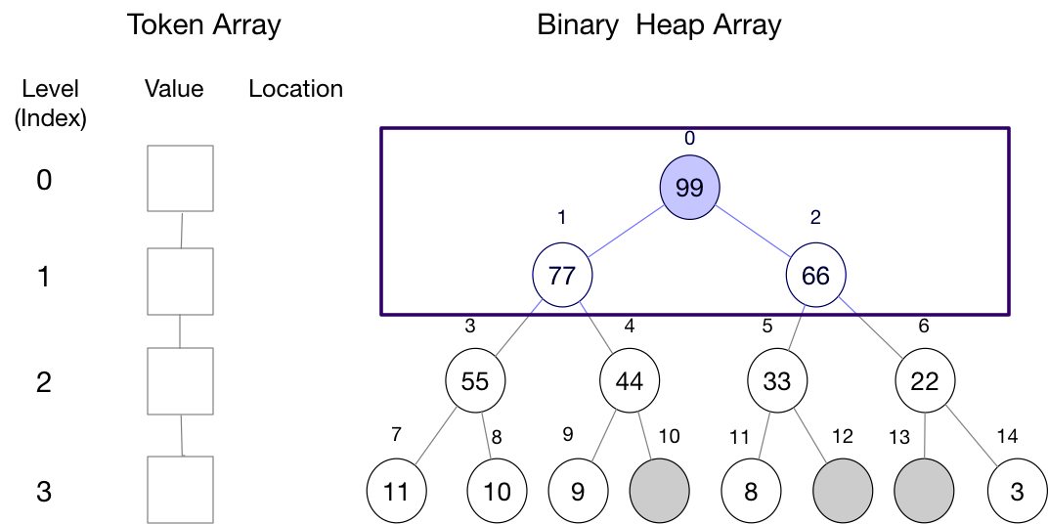
PipelinedPriorityQueue Structure
Notes:
The PipelinedPriorityQueue, which is a little similar to the to the BlockingPriorityQueue,it also has a binaray heap arrary. Which use tree structure to store array. But there are also some differences, you can see it from the graph, pipelined priorityQueue owns two arrays, instead of one like BlockingQueue. The other array is called Token array, which can store the node needed to be inserted, the node contained the the priorityValue, the location of the node in the binary heap array which is compared with, the index of the token array equals the level of the binary heap array. Another different point from Blocking queue is that the binary heap array is not locked with all the levels , instead you can see most a time this strureture need to lock two rows of nodes. OK, next I will show you how to put and poll a node by using pipelinedPrioirtyQueue.

Slide 29
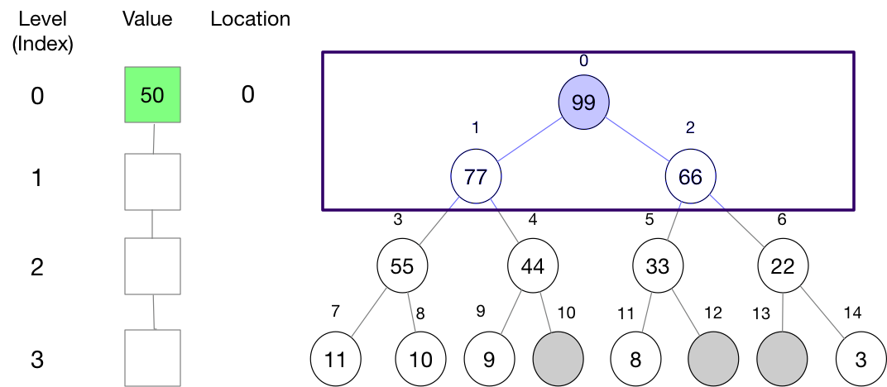
PipelinedPriorityQueue Put - 1
Notes:
Firstly, we intend to insert a node whose value is 50, as you can see, the node is firstly insert to the index 0 pos of the token array and it will compare the value with the node whose position is alos 0, now its value is 99, which is larger than 50, so at this time we should read the two subnodes, whose value are 77 and 66 , unfortunately , 50 is still smaller than both of them , so should move the new node to the next level as basement.

Slide 30
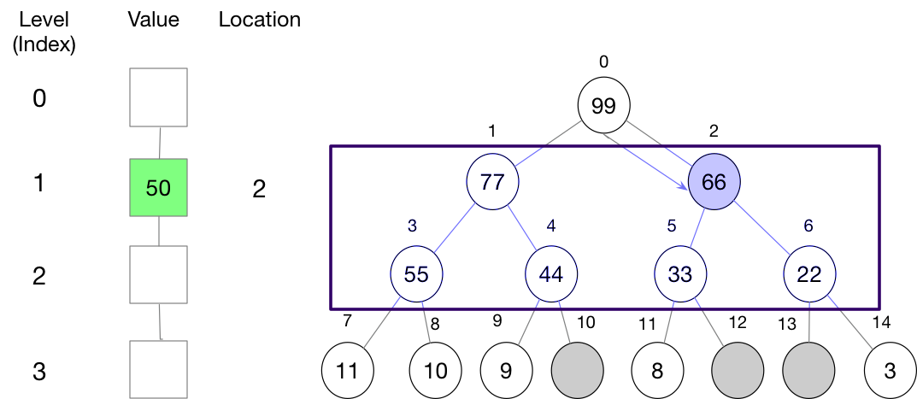
PipelinedPriorityQueue Put - 2
Notes:
But which direction should we choose, there are two directions. You may ask which node should we compare next. So now I have to introduce two attributes in the node of tree. One is the state of the node which only can be inactive and active, as you can see that leaf nodes in the third, you can find 3 gray nodes which mean do not have value, these 3 nodes are also inactive. The other attribute is capacity, which is the count of the inactive nodes in a tree . for instance, 99 hava 3 inactive nodes and the node of index 2 has two inactive nodes because the tree use 66 as root only has 2 inactive nodes. There is a rule that we usually choose the node which has bigger capacity as the target node. When the level increase, the the first level can be unlocked and we lock the 2 the 3 level.

Slide 31
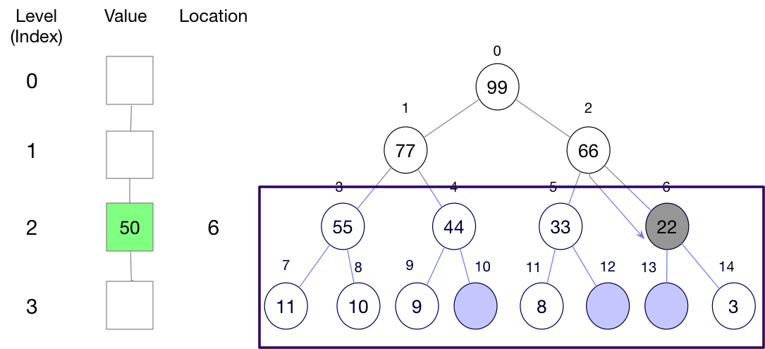
PipelinedPriorityQueue Put - 3

Slide 32
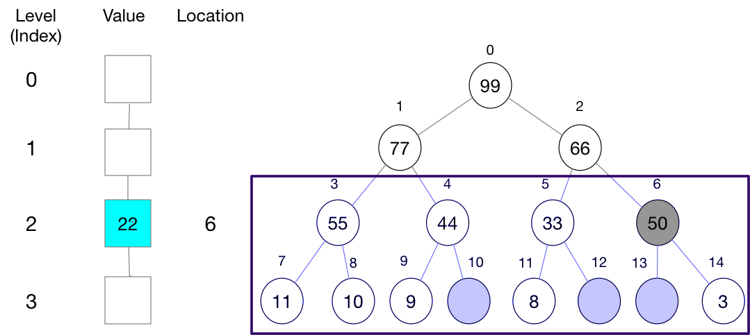
PipelinedPriorityQueue Put - 4

Slide 33
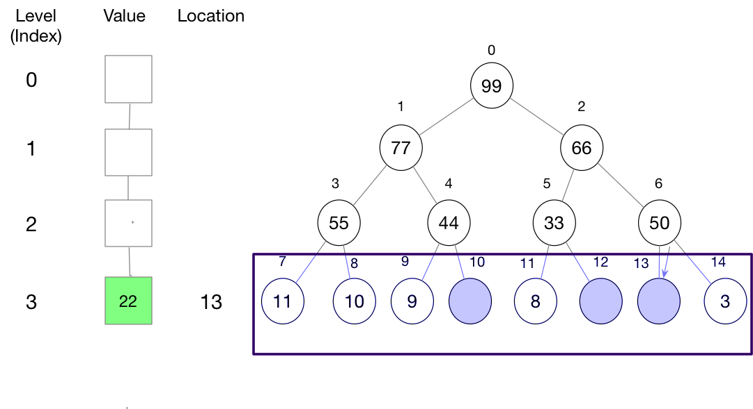
PipelinedPriorityQueue Put - 5

Slide 34
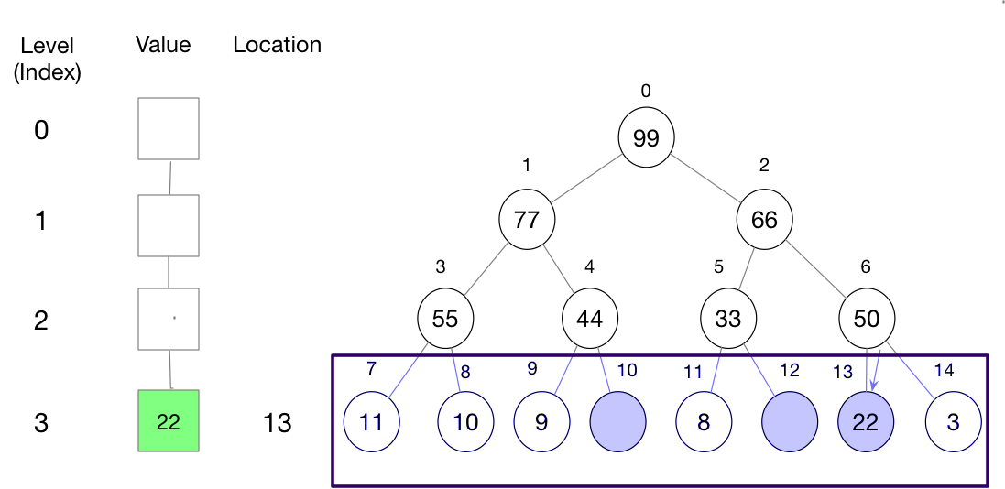
PipelinedPriorityQueue Put - 6

Slide 35
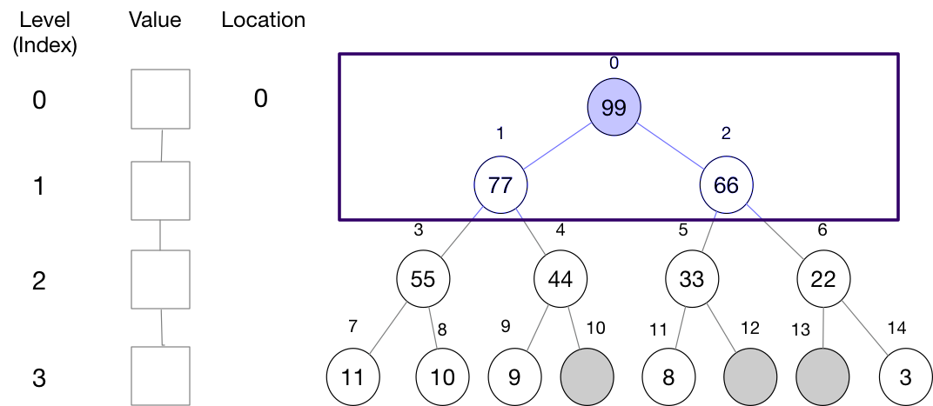
PipelinedPriorityQueue Poll - 1

Slide 36
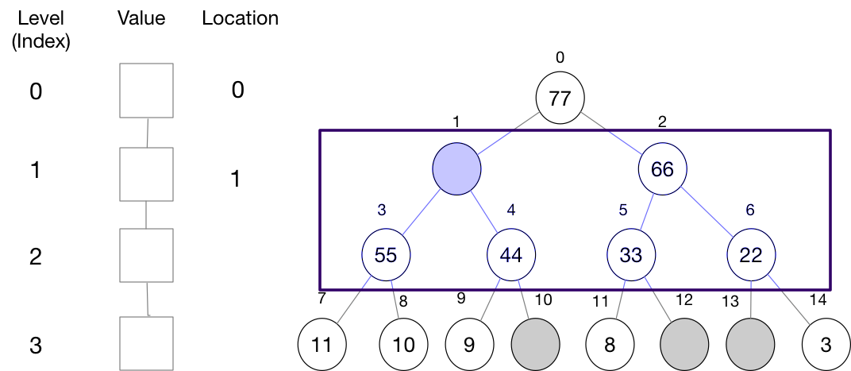
PipelinedPriorityQueue Poll - 2

Slide 37
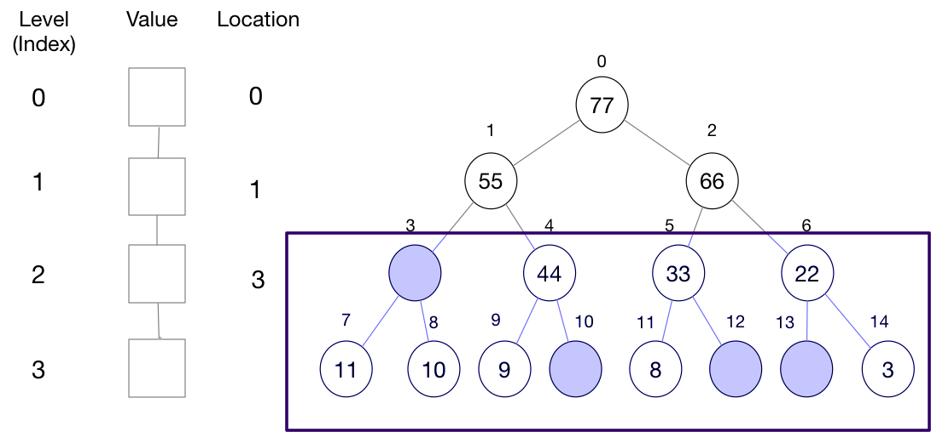
PipelinedPriorityQueue Poll - 3

Slide 38
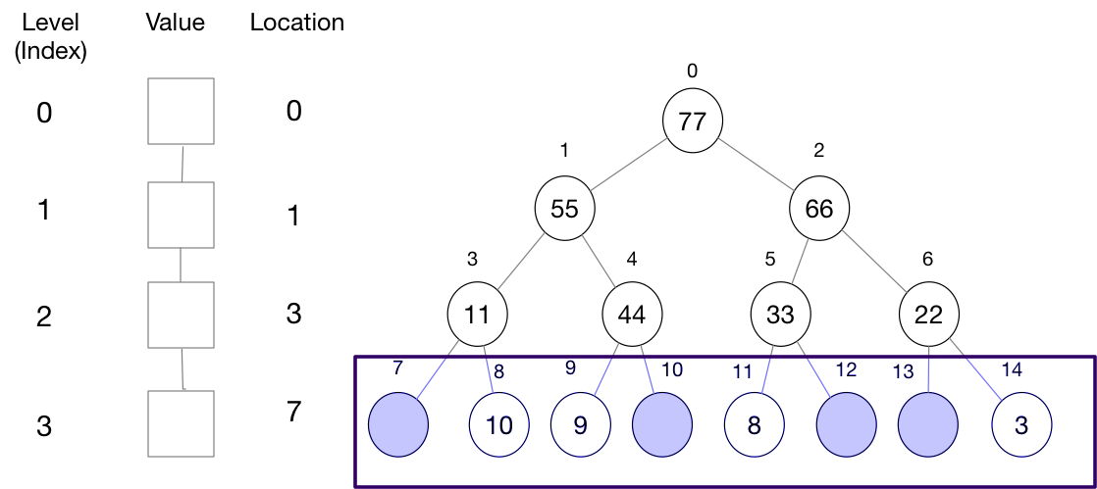
PipelinedPriorityQueue Poll - 4

Slide 39
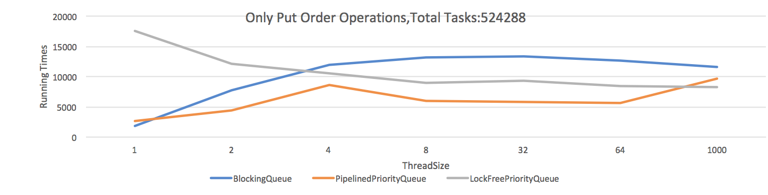
Comparing - Put Order Operations
Notes:
This graph shows the time of dealing with more than 500,000 tasks by 3 collections, all the tasks are sort in order, and then inserted into the collections, with the increasing of the threadsize , time used by blocking queue increases but both lockFreePriorityQueue decllined slowed , but in most time PipelinePriorityQueue spend less time than other two collections.
Slowly decline
Use ler

Slide 40
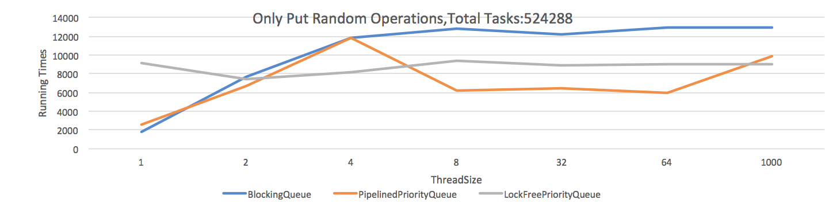
Comparing- Put Random Operations

Slide 41
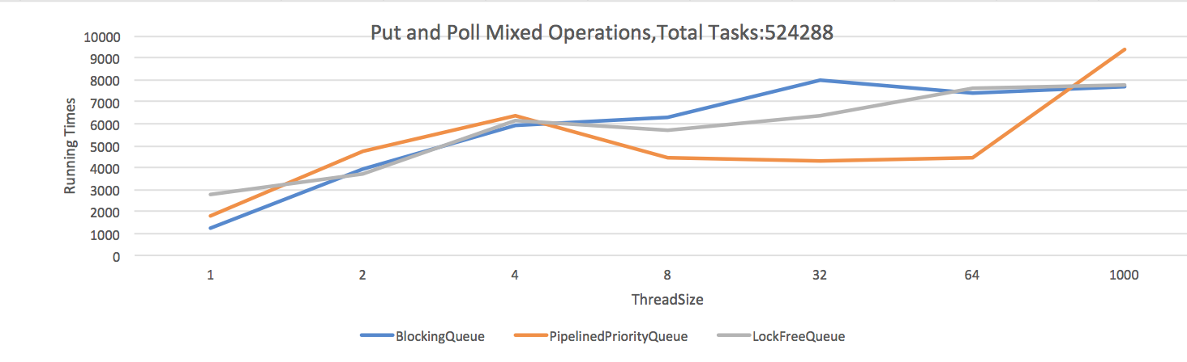
Comparing-Put and Poll Mixed Operations
Notes:
We find that most of time the piplelinePriorityQueue can increase the performance by 30 to 50 percent compare with blockingQueue, and lockFreeQueue can increase the 20 to 30 percent. We also find a inportance thing is that , if there is only one thread , the BlockingQueue performs best, maybe that’s because it need less extra operations than the other collections do.

Slide 42
Conclusion
PriorityBlockingQueue uses a lock to blocking related operations like put and poll.
Pipelined PriorityQueue only locks two levels including the level of current node and the next level.
LockfreePriorityQueue doesn't use a lock,it updates data by atomic methods.
Notes:
In conclusion.
PriorityBlockingQueue uses a lock to blocking related operations like put and poll.
PipelinedPriorityQueue only locks two levels including the level of the current node and the next level.
LockfreePriorityQueue doesn't use a lock, it updates data by atomic methods.

Slide 43
Kahoot!
Let’s have fun!
https://play.kahoot.it/#/?quizId=c31e70d8-3e2d-4b1f-99a5-eb0563a2f738

Slide 44
Reference
Braginsky, A., Cohen, N., & Petrank, E. (2016). CBPQ: High performance lock-free priority queue, http://www.cs.technion.ac.il/~erez/papers.html
Sundell, H., & Tsigas, P. (2005). Fast and lock-free concurrent priority queues for multi-thread systems. Journal of Parallel and Distributed Computing, 65(5), 609-627.
Bhagwan, R., & Lin, B. (2000). Fast and scalable priority queue architecture for high-speed network switches. In INFOCOM 2000. Nineteenth Annual Joint Conference of the IEEE Computer and Communications Societies. Proceedings. IEEE (Vol. 2, pp. 538-547). IEEE.
http://javarevisited.blogspot.co.nz/2013/10/what-is-priorityqueue-data-structure-java-example-tutorial.html#axzz5EEs3dfmS
https://blog.csdn.net/chenssy/article/details/76409396

